Slide 1
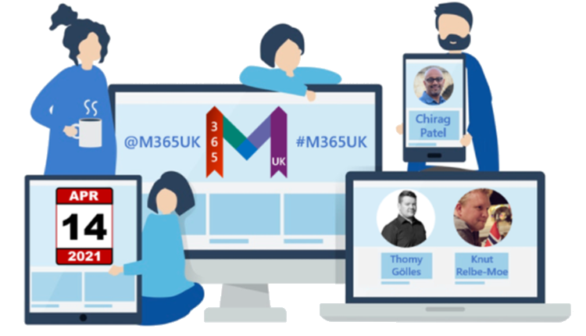
Microsoft Viva, How, what and why
Knut Relbe-Moe (MVP)
@knutrelbemoe

Slide 2

Knut Relbe-Moe
Sky is the limit
√ Founder of DocsNode
√ Works as consultant for Dapt
√ Teams & SharePoint Specialist
√ Worked with delivering Intranets for many years
√ Expert in helping businesses grow their business
√ New role and new opportunity to be announced soon, stay tuned.
knutrelbemoe@outlook.com
https://www.linkedin.com/in/knutrelbemoe/
@knutrelbemoe

Slide 3
Hello from Oslo :-D

Slide 4


Slide 5


Slide 6

What is an Employee Experience Platform (EXP)​ A system of experiences that help organizations create a thriving culture with engaged employees and inspiring leaders
Communications
Announcements, News, Events
Growth & Development
Learning & Coaching
Recruiting, On-boarding & Career
Talent & Performance Development
Company Resources
Employee Portals and Apps
Workplace Services (pay, benefits, IT, legal, compliance)
Wellbeing
Physical, Mental, Emotional, Financial
Insights
Analytics, Nudges, Surveys
Feedback, Sentiment
Employee
Communities
Diversity & Inclusion
Interest groups
Team cohesion
Knowledge
People & Experts
Documents & Content
Projects
Notes:
There has never been a bigger need for technology, data and insights that are designed to enable a great employee experience, regardless of your location.​
Employees want to feel more connected, more aligned to their company purpose and mission. They want to grow, make an impact, and make a difference.​
Leaders need a modern way to engage and develop their employees ​
And IT needs to be able to quickly enable this modern employee experience without having to rip and replace all their existing systems. IT buyers are concerned with:
Managing fragmented apps & limiting tech sprawl.
Reducing technology and integration costs.
Showcasing tech as an enabler of business/culture outcomes.
What is needed is a new approach and a new category of technology solutions we call Employee Experience platforms or EXP.​
An EXP is a digital platform that puts people at the center by bringing together systems of work with systems of support into an integrated employee experience, and it provides people with the resources and support they need to succeed and thrive, no matter their location. ​It also needs to provide an open and extensible platform that is customizable and works with your existing systems and tools.
Today, there are a lot of vendors focused on employee engagement and wellbeing. But they are mostly point solutions looking to solve one or a few of the symptoms in separate experiences.
Today’s solutions are fragmented, and they are disconnected from where people are doing their work. The services and resources employees need are often undiscovered or locked up in systems of record rather than a natural part of people’s communication and workflow.​
The vision for Viva is an integrated employee experience that brings together all these resources into the natural flow of everyday work.​

Slide 7




Microsoft Viva Insights
Balance productivity and wellbeing.
Microsoft Viva Topics
Connect to knowledge and experts.
Microsoft Viva
Empower people and teams to be their best
Microsoft Viva Learning
Make learning a natural part of your day.
Microsoft Viva Connections
Stay engaged and informed.
Viva Insights | Give employees, managers and leaders data-driven insights that help everyone work smarter and thrive.​
Viva Topics | Organize content and expertise across systems and teams to deliver just-in-time knowledge in the apps people use every day
Viva Learning | Discover, share, and engage in learning to grow personally and professionally​
Viva Connections | Shape culture, foster connections, and modernize the employee experience​

Slide 8



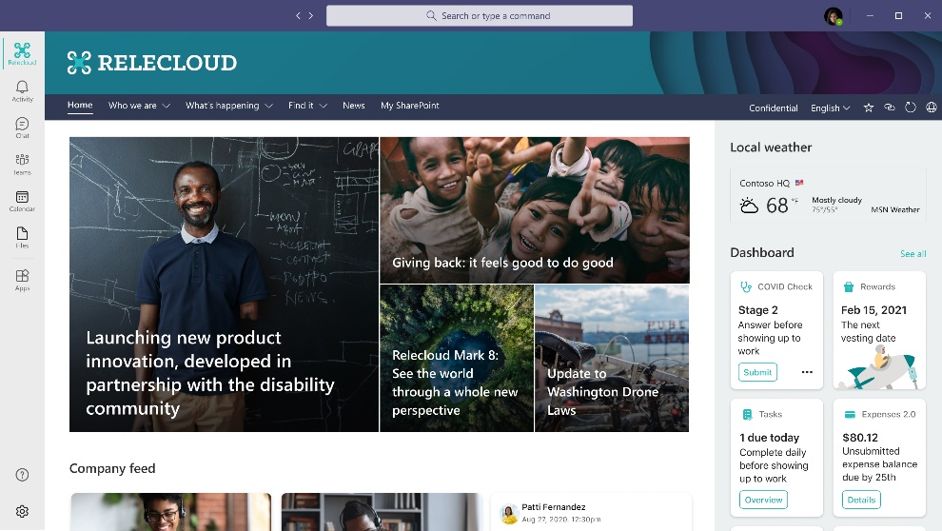
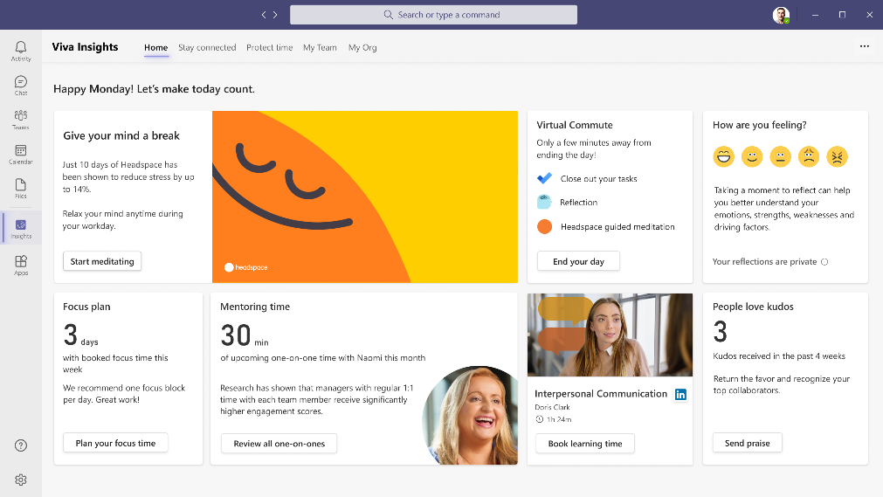
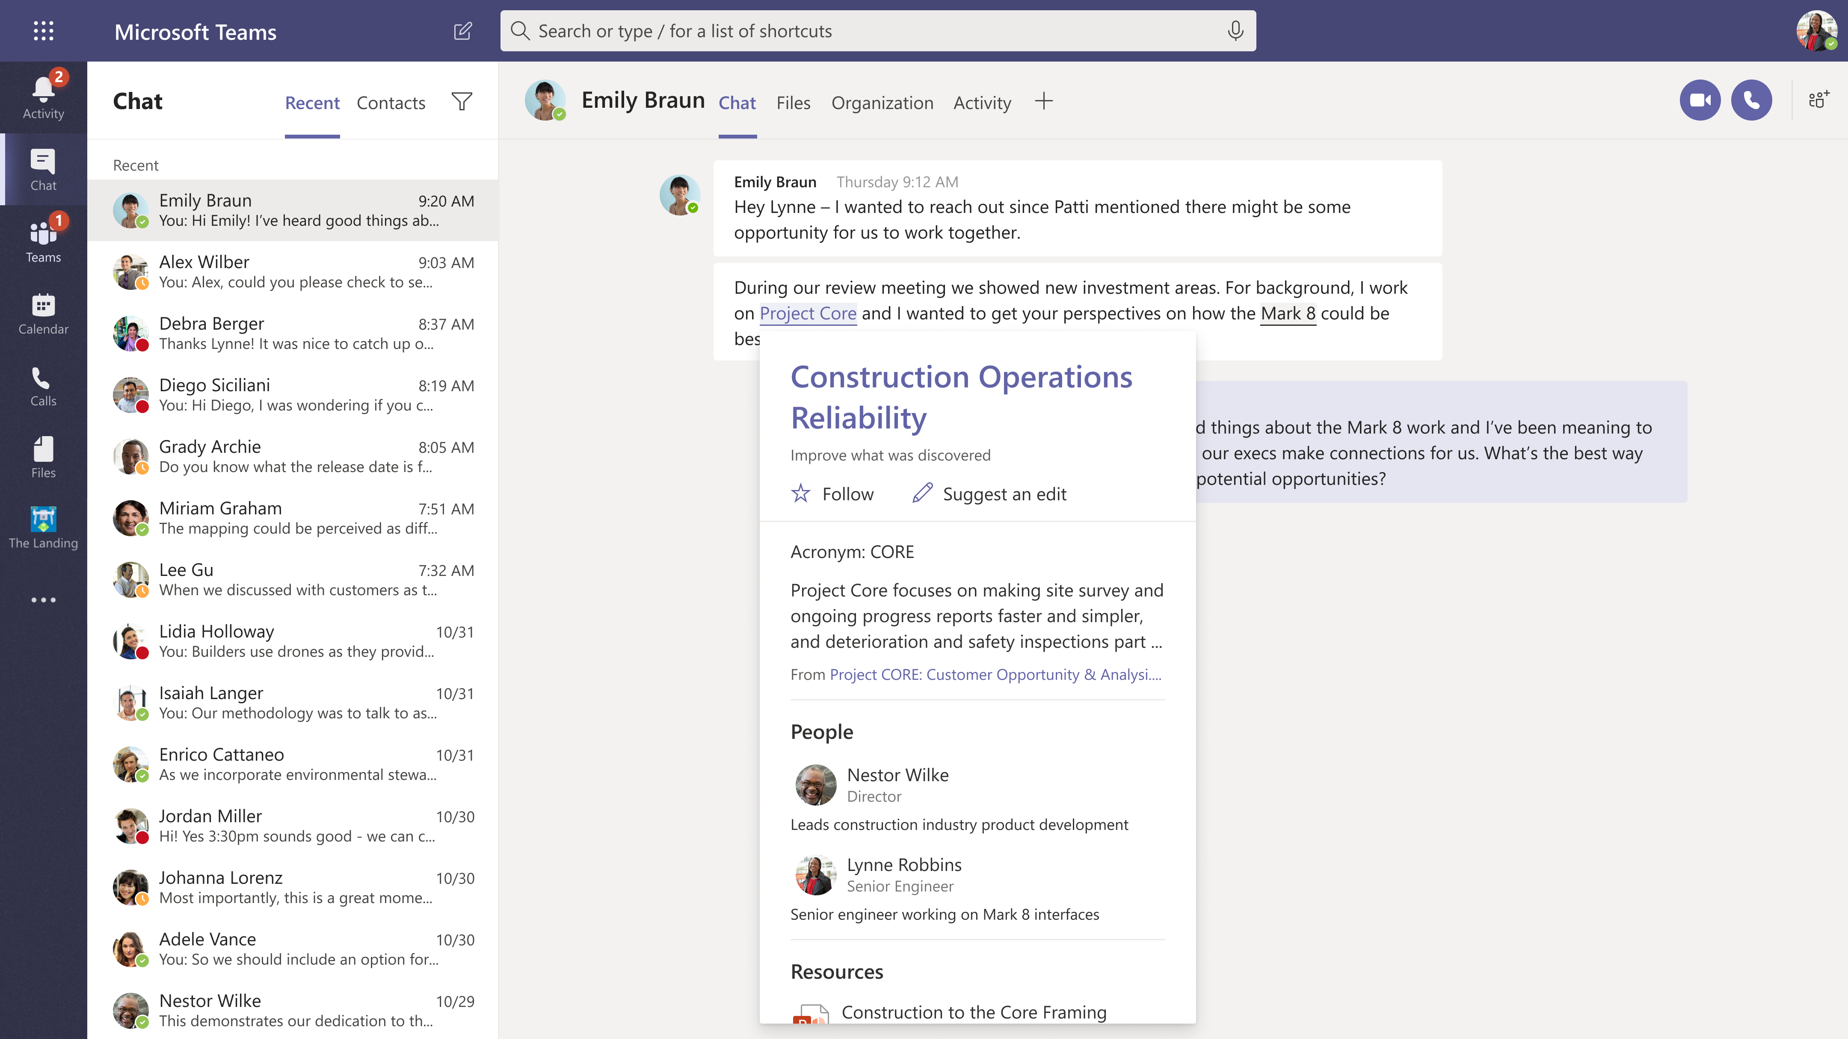
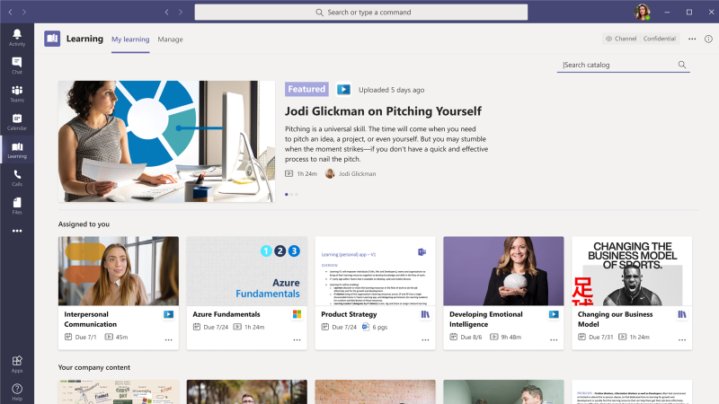


Microsoft Viva
Empower people and teams to be their best
Connections
Culture and communications
Insights
Productivity and wellbeing
Topics
Knowledge and expertise
Learning
Skilling and growth
Notes:
To start with, Viva will have these 4 modules that you see here, and we’ll be adding more in the future.
Each of these builds on existing capabilities in Microsoft 365 and are integrated directly in Teams, as you can see from the UI here for each module.
I’ll provide a quick description of the modules now and then we’ll go deeper into each one in the following sections.
Connections is a company branded employee app in Teams. It is a gateway to your employee experience, with personalized news, communications, tasks, people and resources.​ It provides a single curated employee destination that can be configured for specific roles like frontline workers. So, leaders can communicate and engage their employees, and employees can get easy access to the tools and resources they need from one place.. Connections builds on existing capabilities in Microsoft 365 like SharePoint and Yammer. And it pulls your communications together into a pre-configured app in Teams, designed for both desktop and mobile workers. It also acts as a launching pad to the other 3 Viva modules
Insights brings together Workplace Analytics, MyAnalytics and Glint into a unified insights app in Teams to provide data-driven and privacy-protected insights for individuals, managers and leaders. For example, employees get personalized insights, only they can see, that help them protect their time for breaks, focused work, and learning in order to promote improved productivity and wellbeing.
Topics focuses on knowledge and expertise. Topics applies AI to identify knowledge and experts and organize them into shared topics. AI automatically creates a topic page for each topic. It’s like Wikipedia for the enterprise where AI does the first draft. And these topic pages are surfaced as Topic Cards right in the flow of work in Office and Teams.
Finally, Learning allows employees to easily discover informal and formal learning in the flow of work. It aggregates content from LinkedIn Learning, Microsoft Learn and 3rd party training content and your own organizations content – all in one place. Along with providing aggregation and recommendations, it also allows managers to assign and track training, as well as report on training within and across teams.

Slide 9



Microsoft Viva
What makes it unique?
Organization layer for employee experiences through Microsoft Teams
People at the center with skills, resources in the flow of work
Powerful insights that are actionable
Privacy and security that you can trust
Platform and ecosystem with customization and extensibility
Notes:
Microsoft Viva is unique in 5 key ways:
It is an integrated system of employee experiences instead of the fragmented point solutions that exist in each of these categories today.
It puts people at the center by delivering personalized experiences, embedded into the apps people use everyday like Microsoft Teams and Office
It provides powerful insights for individuals, teams and leaders based on the Microsoft Graph.
It has privacy and security you can trust. For example, your personal data can only be viewed by you. All manager and leader insights are deidentified with differential privacy, and the data can only be viewed by managers with orgs of 10 or more people.
5) And finally, Microsoft Viva provides an open and extensible platform, with an ecosystem of partners so Viva works with your existing systems and tools. Viva is designed so customers can leverage their existing investments in Microsoft technologies as well as their existing systems for HR, Learning and Wellbeing.

Slide 10

Microsoft 365
CRM
Teams
SharePoint
Yammer
LinkedIn
Microsoft Search
Glint
& more
Dynamics 365
Salesforce
Microsoft Viva
Ecosystem
Content providers
Communications
Coursera
edX
LinkedIn Learning
Microsoft Learn
Pluralsight
Skillsoft
Teams
Outlook
Yammer
Slack
Zoom
Wellbeing
Digital workflows
Glint
Headspace
ServiceNow
HR & Learning
Cornerstone OnDemand
Dynamics 365
Saba
SAP SuccessFactors
Workday
And many more coming…
Later this year, we intend to make APIs publicly available so our broad ecosystem of customers and partners can also integrate with Microsoft Viva
Notes:
Customers have told us that they don’t want to start from scratch with a completely new system or to rip and replace their existing systems like HCM or LMS systems of record. Instead, they want to extend their existing investments, by better connecting them together and by making them available in a more modern experience to their employees.
So we are taking a Platform and Ecosystem approach with Viva. These are partners integrations that we have already announced, and we are already working on our next wave of partnerships that will land later this year. Later this year, we intend to make APIs publicly available so our broad ecosystem of customers and partners can also integrate with Microsoft Viva.
Let’s dive a little deeper into the modules themselves, beginning with Viva Connections.

Slide 11
Viva Connections
Why should you deploy it?

Slide 12

Nearly 60% of people say they feel less connected to their team after shifting to remote work.
Microsoft Work Trend Index, 2020
Notes:
We know that a sense of belonging is important to have at work. Employees who feel like they belong are happier and stay at their jobs longer. However, nearly 60% of people say they feel less connected to their team since the shift to remote work (Work Trend Index), which leads us to a common question that’s been asked during the pandemic: how can we create the connectedness we feel from in-person work while working remotely?

Slide 13
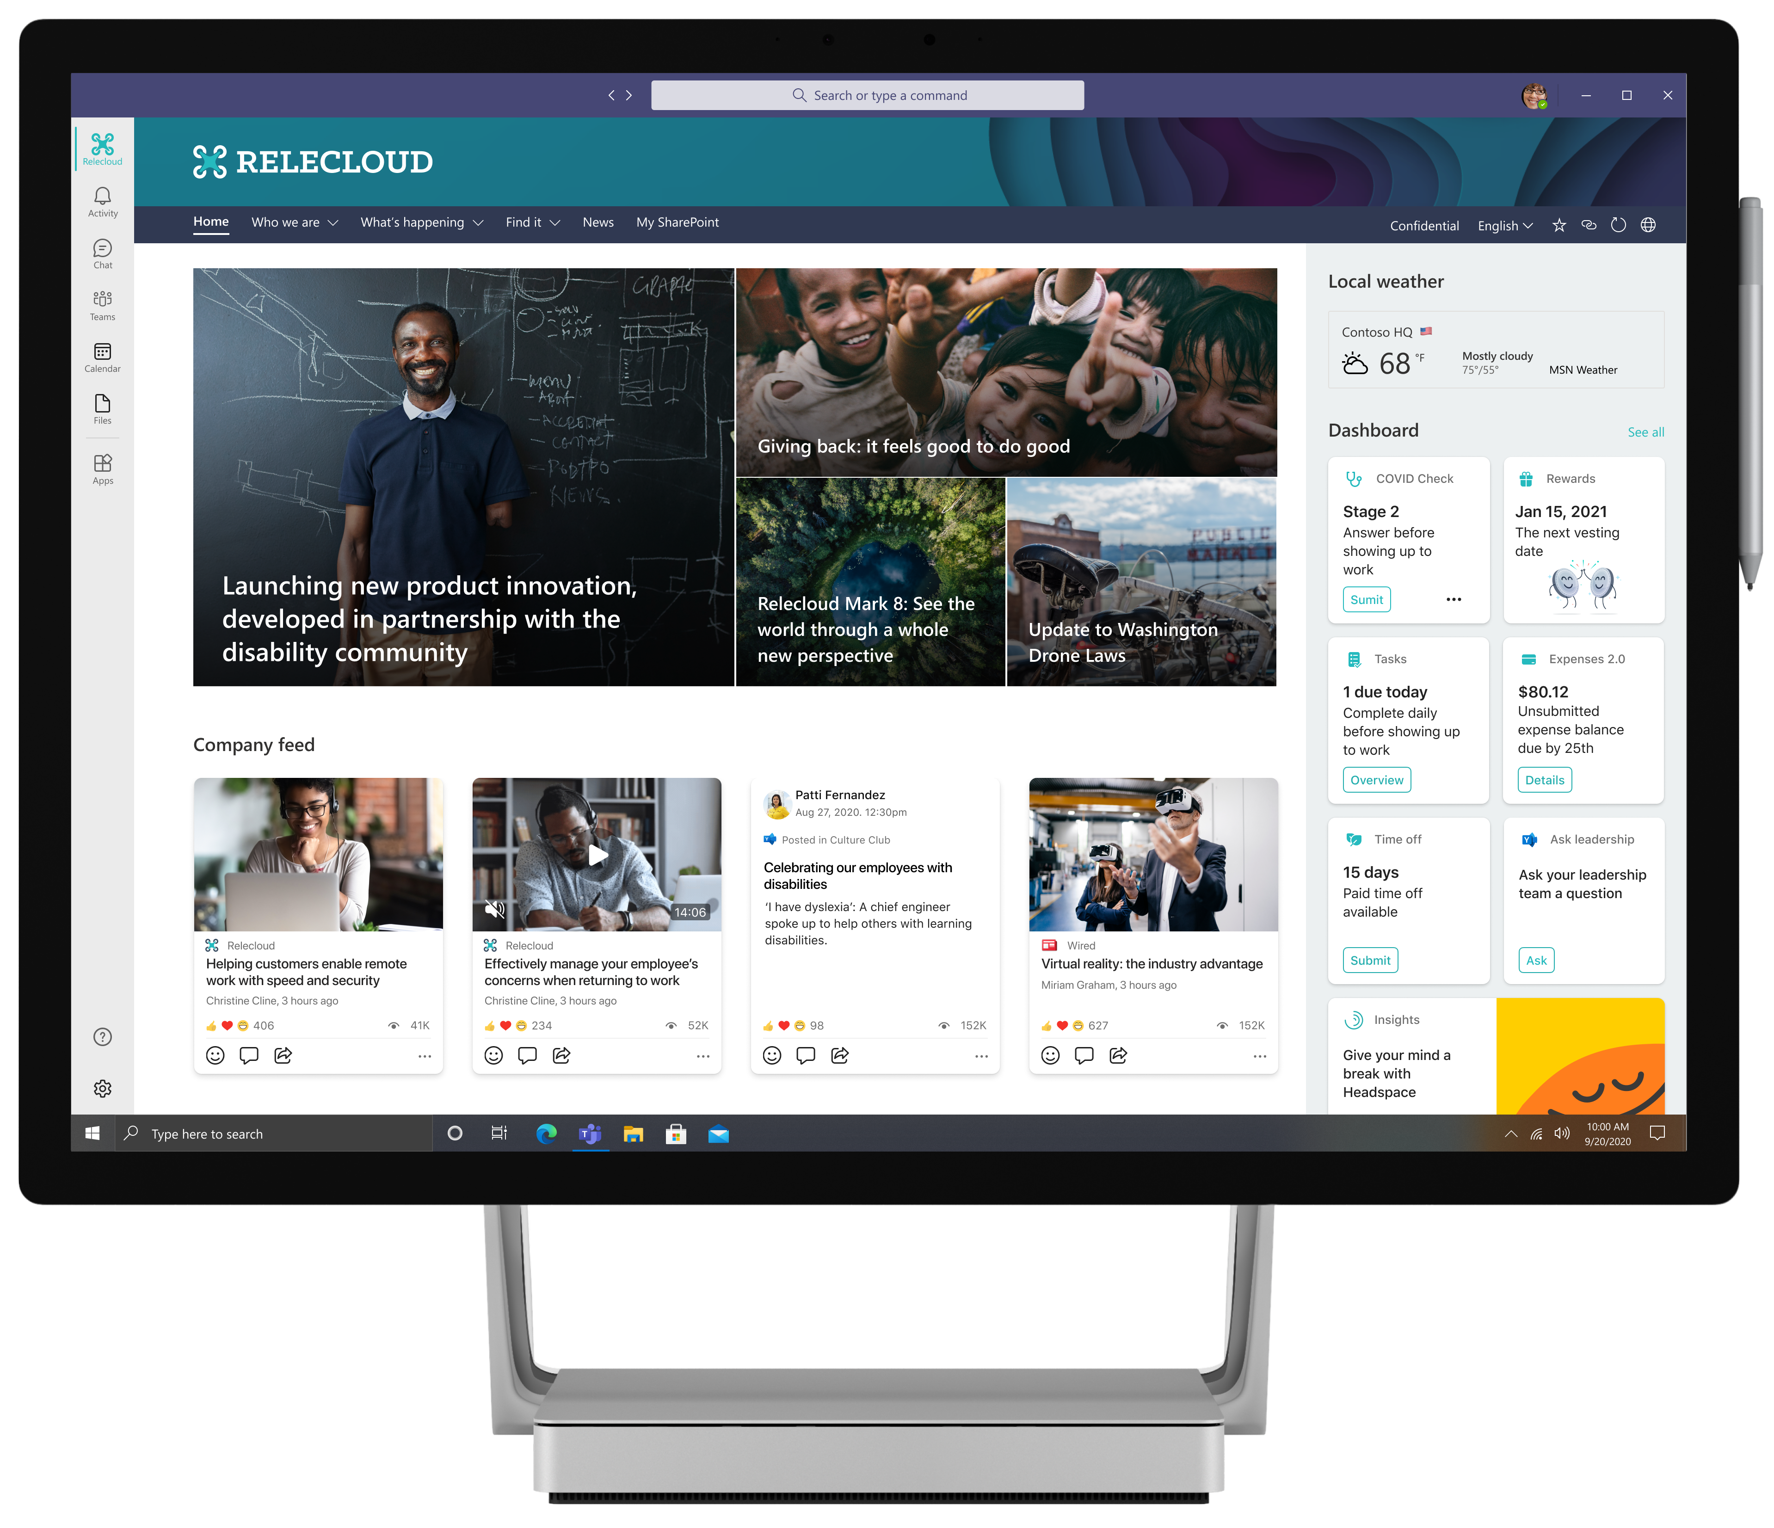
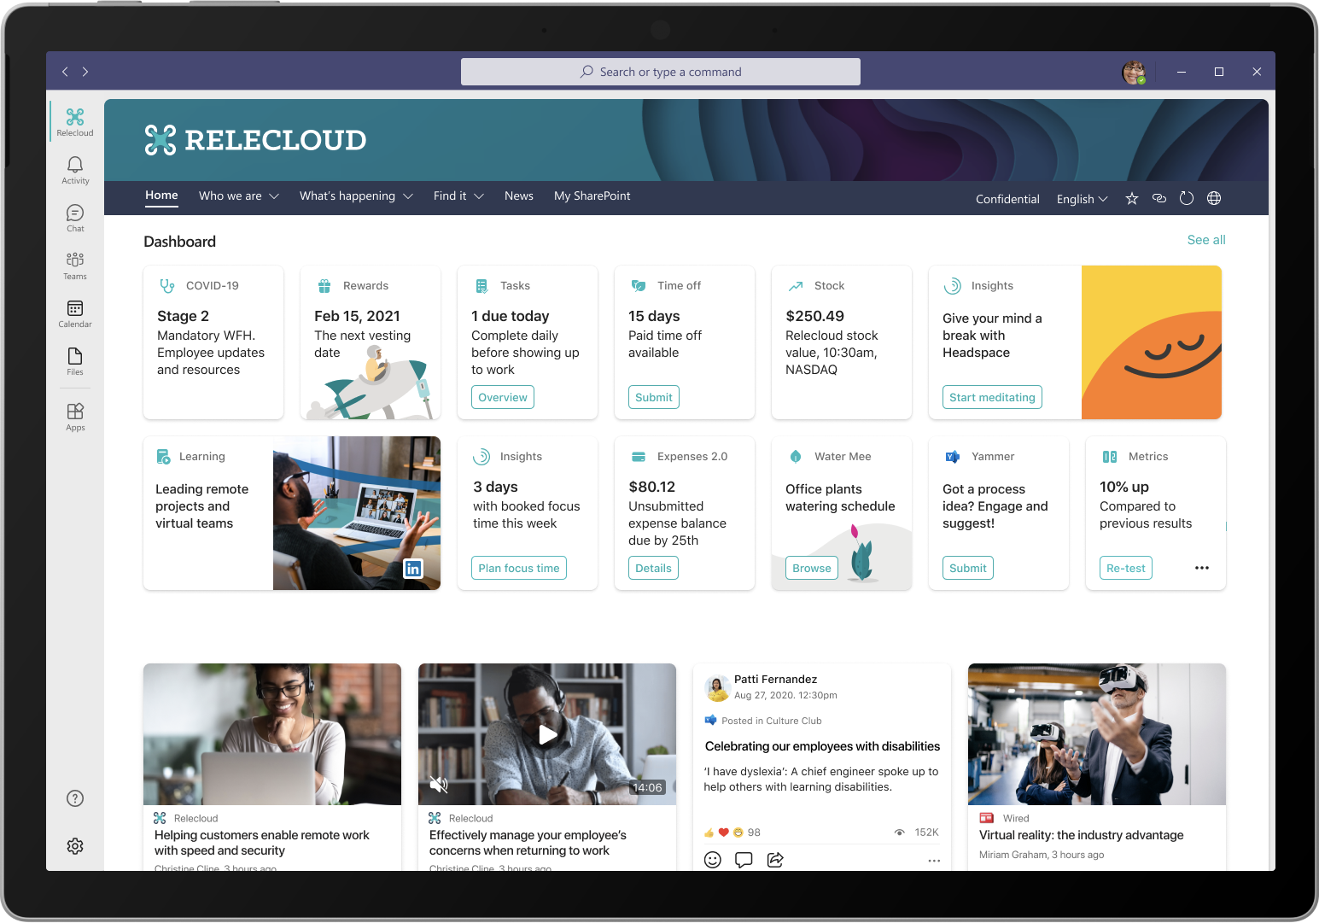
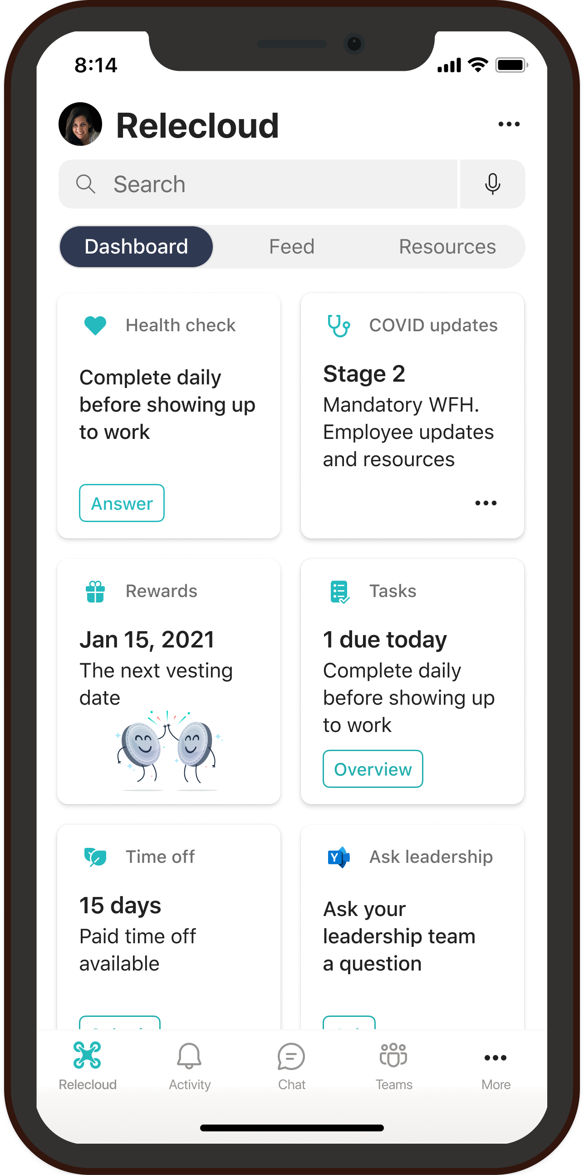
Viva Connections Communications and culture
Keep everyone connected
Encourage meaningful connections across the organization by enabling employees to easily discover relevant communications and communities.
Make it easy for people to contribute
Foster a culture of inclusion by empowering every employee to contribute ideas and share feedback.
Unite and inspire your organization
Align the entire organization around your vision, mission, and strategic priorities
Notes:
Viva Connections was created to keep everyone in the workforce connected to each other. It makes it easy for people to contribute and to unite your organization around the company’s vision.
Today, in M365 there are a lot of capabilities for employee communications and engagement. There is SharePoint, Yammer, Teams and Stream. Viva Connections brings all of this together into a company branded app in Teams.
Over the last 18 months, we’ve made significant progress integrating these tools together. For example, the new Yammer communities app in Teams, with Live events, so employees can watch their company all-hands and engage in real-time Q&A across the company right from within Teams.
Connections is the next evolution of this. Customers have been saying they want a pre-configured experience, that is company branded, and mobile-first, and they want it customizable for different roles.
Connections comes with a dashboard for actions and reminders. A personalized feed for company news and information. And resources where we link to the other Viva experiences like Learning and Insights.
Customers and partners can brand and customize it as their own ‘employee app’, as well as customize the dashboard and resources.
Overall, this can be a valuable channel to help people stay connected to leaders and to each other, understand company strategies and objectives, as well as ideate and collaborate on common interests and passions. The interactive aspects of the Microsoft Viva Company App contribute to a sense of belonging that helps people feel connected to others and stay engaged throughout the workday.
We think this is a really powerful concept that adds to the Frontline capabilities we already have in Teams. – and can be a unifying application, helping tie together the different services into a single experience

Slide 14

Viva Connections
Demo

Slide 15

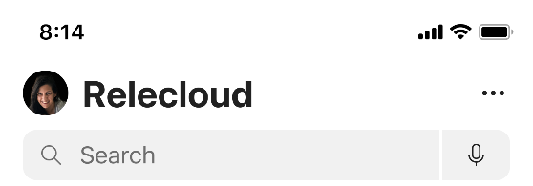
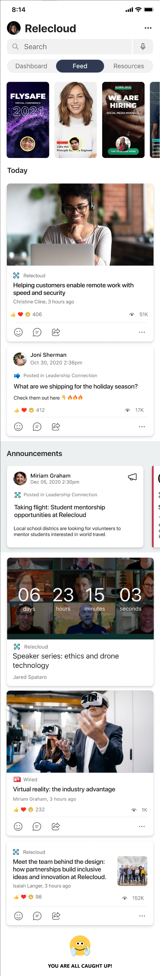
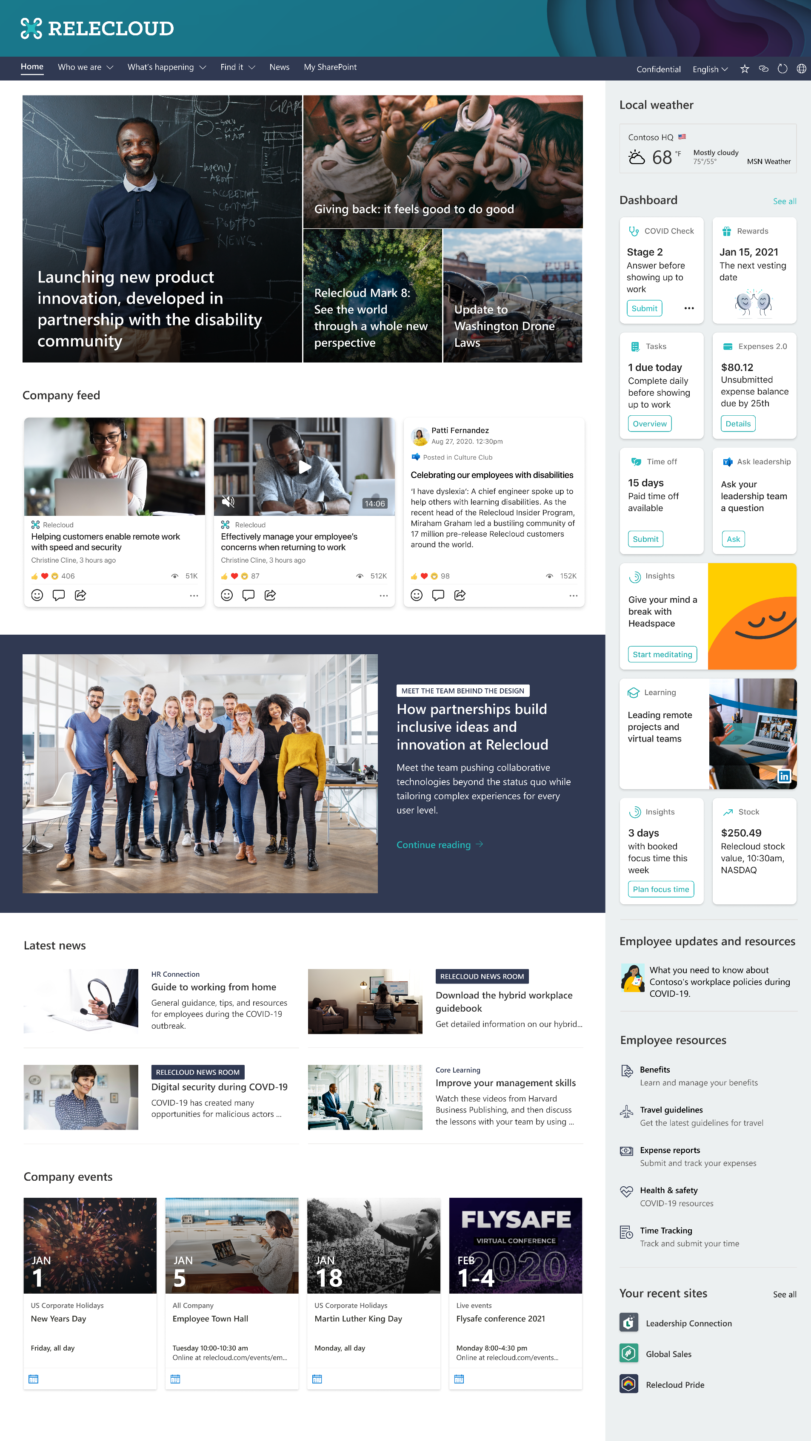


Notes:
Viva Connections is your gateway to a modern experience, allowing you to stay engaged and informed no matter where you work.
[CLICK]

Slide 16
Notes:
Here’s an example for a company called Relecloud.
The Connections app is pinned to the top of the app bar—the left rail—in Teams.
As you can see, Connections is customized for your organization.
And what you see is personalized for you—based on your role and location, for example.
[CLICK]

Slide 17
Notes:
[SLIDES ADVANCE AUTOMATICALLY AS YOU SPEAK]
There’s a personalized feed of relevant news, announcements, and conversations so you’re always in the know
You can keep up with important announcements
from your company and your teams
and join in valuable conversations with people across the organization with Viva’s integration to Yammer

Slide 18
Notes:
[SLIDES ADVANCE AUTOMATICALLY AS YOU SPEAK]
There’s a personalized feed of relevant news, announcements, and conversations so you’re always in the know
You can keep up with important announcements
from your company and your teams
and join in valuable conversations with people across the organization with Viva’s integration to Yammer

Slide 19
Notes:
[SLIDES ADVANCE AUTOMATICALLY AS YOU SPEAK]
There’s a personalized feed of relevant news, announcements, and conversations so you’re always in the know
You can keep up with important announcements
from your company and your teams
and join in valuable conversations with people across the organization with Viva’s integration to Yammer

Slide 20

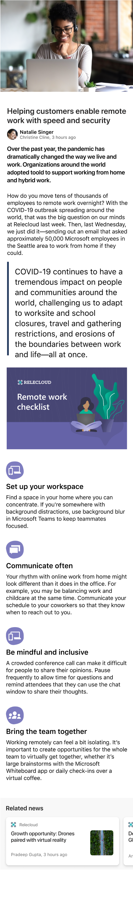

Notes:
[SLIDES ADVANCE AUTOMATICALLY AS YOU SPEAK]
There’s a personalized feed of relevant news, announcements, and conversations so you’re always in the know
You can keep up with important announcements
from your company and your teams
and join in valuable conversations with people across the organization with Viva’s integration to Yammer

Slide 21
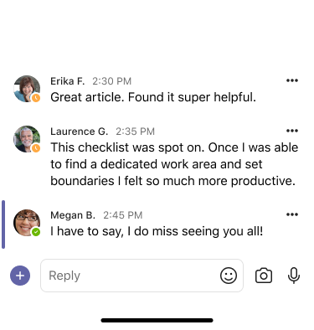
Notes:
[SLIDES ADVANCE AUTOMATICALLY AS YOU SPEAK]
There’s a personalized feed of relevant news, announcements, and conversations so you’re always in the know
You can keep up with important announcements
from your company and your teams
and join in valuable conversations with people across the organization with Viva’s integration to Yammer
[CLICK]

Slide 22
Notes:
[SLIDE ADVANCES AUTOMATICALLY]

Slide 23
Notes:
[SLIDES ADVANCE AUTOMATICALLY AS YOU SPEAK]
The feed uses
content and signals from Microsoft Graph
to make it personalized, and relevant to you.
And your organization can target communications and featured conversations,
to make sure the right information gets to the right people, wherever they work

Slide 24
Notes:
[SLIDES ADVANCE AUTOMATICALLY AS YOU SPEAK]
The feed uses
content and signals from Microsoft Graph
to make it personalized, and relevant to you.
And your organization can target communications and featured conversations,
to make sure the right information gets to the right people, wherever they work

Slide 25
Notes:
[SLIDES ADVANCE AUTOMATICALLY AS YOU SPEAK]
The feed uses
content and signals from Microsoft Graph
to make it personalized, and relevant to you.
And your organization can target communications and featured conversations,
to make sure the right information gets to the right people, wherever they work

Slide 26
Notes:
[SLIDES ADVANCE AUTOMATICALLY AS YOU SPEAK]
The feed uses
content and signals from Microsoft Graph
to make it personalized, and relevant to you.
And your organization can target communications and featured conversations,
to make sure the right information gets to the right people, wherever they work

Slide 27
Notes:
[SLIDES ADVANCE AUTOMATICALLY AS YOU SPEAK]
The feed uses
content and signals from Microsoft Graph
to make it personalized, and relevant to you.
And your organization can target communications and featured conversations,
to make sure the right information gets to the right people, wherever they work
[CLICK]

Slide 28
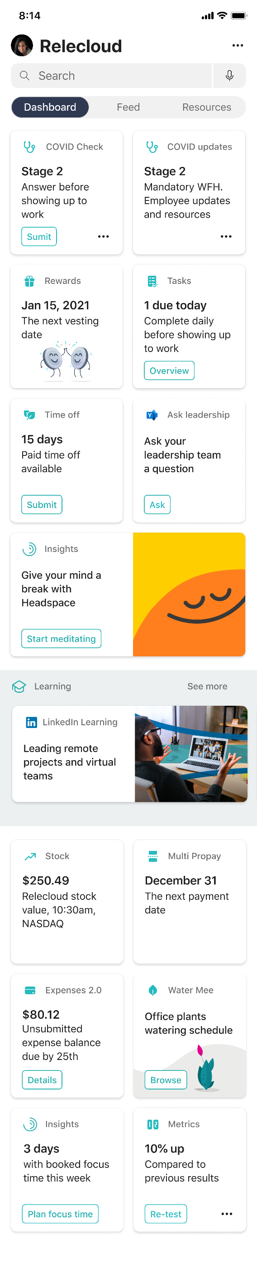

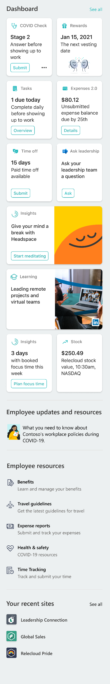
Notes:
[SLIDES ADVANCE AUTOMATICALLY AS YOU SPEAK]
In addition to the personalized feed of news and conversation, Connections gives you a personalized dashboard.
Your dashboard is a single destination for all the helpful company resources and tools you need as an employee
such as health checks, time off requests, … [continuing]
[CLICK]

Slide 29

Notes:
[SLIDES ADVANCE AUTOMATICALLY AS YOU SPEAK]
In addition to the new, personalized feed of news and conversation, Connections gives you a personalized dashboard.
Your dashboard is a single destination for all the helpful company resources and tools you need as an employee
such as health checks, time off requests… [continuing]
[CLICK]

Slide 30
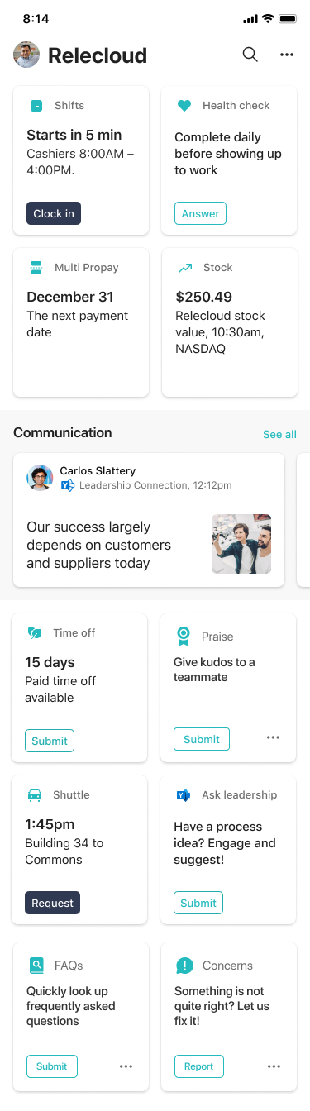
Notes:
…and resources for wellbeing and learning,
like this reminder to take a break coming from Viva Insights,
And this recommended training from Viva Learning
[CLICK]

Slide 31
Notes:
Of course, the dashboard is available in Teams mobile as well
[CLICK]
Bringing the same personalized experience to iOS and Android users.
[CLICK]

Slide 32
Notes:
And you can tailor the experience for every role.
For example, you can add things like shifts and tasks specific that are specific to front line workers
[CLICK]

Slide 33
Notes:
Viva Connections builds on Microsoft 365 capabilities like SharePoint and Yammer
and can integrate apps from across your digital workplace.
Deliver a modern, personalized employee experience that keeps everyone connected and engaged, wherever they work, with Viva Connections.
[CLICK]

Slide 34
Viva Connections
Installing Viva Connections Desktop

Slide 35
Deploying Viva Connections
Before you can experience the benefits of Viva Connections there are a few steps that you need to complete:
Prerequisites
Create a company wide portal/intranet using SharePoint communication sites, typically as a hub with connected sites (top tip – if you want to set it as your root site do it before registering as a hub)
Register as home site (recommended to also set as root site)
Enable global navigation to enable the SharePoint app bar (not available in all tenants yet – we don’t have it ☹)
Get the latest version of the SharePoint Management Shell
Download the zip file containing the installation materials
Get a 192x192 pixel colour icon for the app catalog
Get a 32x32 pixel monochrome icon for the app bar (it must be monochrome – my first attempt had a slight drop shadow and it looked terrible)
Notes:
PowerShell - https://docs.microsoft.com/en-us/powershell/sharepoint/sharepoint-online/introduction-sharepoint-online-management-shell?view=sharepoint-ps
Register home site - https://docs.microsoft.com/en-us/sharepoint/home-site
Root site - https://docs.microsoft.com/en-us/sharepoint/modern-root-site#replace-your-root-site
Global nav - https://docs.microsoft.com/en-gb/SharePoint/sharepoint-app-bar?WT.mc_id=M365-MVP-5003360#customize-global-navigation-in-the-app-bar
Install files - https://www.microsoft.com/en-us/download/confirmation.aspx?id=102888
Rollout paused - https://admin.microsoft.com/AdminPortal/Home?ref=MessageCenter/:/messages/MC240066

Slide 36
Deploying Viva Connections
The install process involves running a PowerShell script to create app package which you can then upload and deploy via the Teams Admin Center. This method allows you to deploy to a test group using app policies before deploying globally.
PowerShell script
You will be prompted to provide the following information:
SharePoint site URL
App name (keep it short for the app bar)
App description (80 character description for the app catalog)
App long description (4000 character description for the app catalog)
Privacy policy URL (option to use MS default)
Terms of use URL (option to use MS default)
Organisation name (used for the ‘created by’ section in app catalog)
Organisation website (link in the ‘created by’ section in app catalog)
Upload icons mention in the prerequisites.
Notes:
PowerShell - https://docs.microsoft.com/en-us/powershell/sharepoint/sharepoint-online/introduction-sharepoint-online-management-shell?view=sharepoint-ps
Register home site - https://docs.microsoft.com/en-us/sharepoint/home-site
Root site - https://docs.microsoft.com/en-us/sharepoint/modern-root-site#replace-your-root-site
Global nav - https://docs.microsoft.com/en-gb/SharePoint/sharepoint-app-bar?WT.mc_id=M365-MVP-5003360#customize-global-navigation-in-the-app-bar
Install files - https://www.microsoft.com/en-us/download/confirmation.aspx?id=102888

Slide 37
Deploying Viva Connections
The final stage of the process is to deploy the app package via the Teams Admin Center.
Deploy via the Teams Admin Center
Notes:
PowerShell - https://docs.microsoft.com/en-us/powershell/sharepoint/sharepoint-online/introduction-sharepoint-online-management-shell?view=sharepoint-ps
Register home site - https://docs.microsoft.com/en-us/sharepoint/home-site
Root site - https://docs.microsoft.com/en-us/sharepoint/modern-root-site#replace-your-root-site
Global nav - https://docs.microsoft.com/en-gb/SharePoint/sharepoint-app-bar?WT.mc_id=M365-MVP-5003360#customize-global-navigation-in-the-app-bar
Install files - https://www.microsoft.com/en-us/download/confirmation.aspx?id=102888

Slide 38
References
The final stage of the process is to deploy the app package via the Teams Admin Center.
PowerShell
https://docs.microsoft.com/en-us/powershell/sharepoint/sharepoint-online/introduction-sharepoint-online-management-shell?view=sharepoint-ps
Register Home Site
https://docs.microsoft.com/en-us/sharepoint/home-site
Root Site
https://docs.microsoft.com/en-us/sharepoint/modern-root-site#replace-your-root-site
Notes:
PowerShell - https://docs.microsoft.com/en-us/powershell/sharepoint/sharepoint-online/introduction-sharepoint-online-management-shell?view=sharepoint-ps
Register home site - https://docs.microsoft.com/en-us/sharepoint/home-site
Root site - https://docs.microsoft.com/en-us/sharepoint/modern-root-site#replace-your-root-site
Global nav - https://docs.microsoft.com/en-gb/SharePoint/sharepoint-app-bar?WT.mc_id=M365-MVP-5003360#customize-global-navigation-in-the-app-bar
Install files - https://www.microsoft.com/en-us/download/confirmation.aspx?id=102888

Slide 39
References
The final stage of the process is to deploy the app package via the Teams Admin Center.
Global Nav
https://docs.microsoft.com/en-gb/SharePoint/sharepoint-app-bar?WT.mc_id=M365-MVP-5003360#customize-global-navigation-in-the-app-bar
Install files
https://www.microsoft.com/en-us/download/confirmation.aspx?id=102888
Rollout Paused
https://admin.microsoft.com/AdminPortal/Home?ref=MessageCenter/:/messages/MC240066
Notes:
PowerShell - https://docs.microsoft.com/en-us/powershell/sharepoint/sharepoint-online/introduction-sharepoint-online-management-shell?view=sharepoint-ps
Register home site - https://docs.microsoft.com/en-us/sharepoint/home-site
Root site - https://docs.microsoft.com/en-us/sharepoint/modern-root-site#replace-your-root-site
Global nav - https://docs.microsoft.com/en-gb/SharePoint/sharepoint-app-bar?WT.mc_id=M365-MVP-5003360#customize-global-navigation-in-the-app-bar
Install files - https://www.microsoft.com/en-us/download/confirmation.aspx?id=102888

Slide 40
Viva Topics
What you need to know before you get started

Slide 41
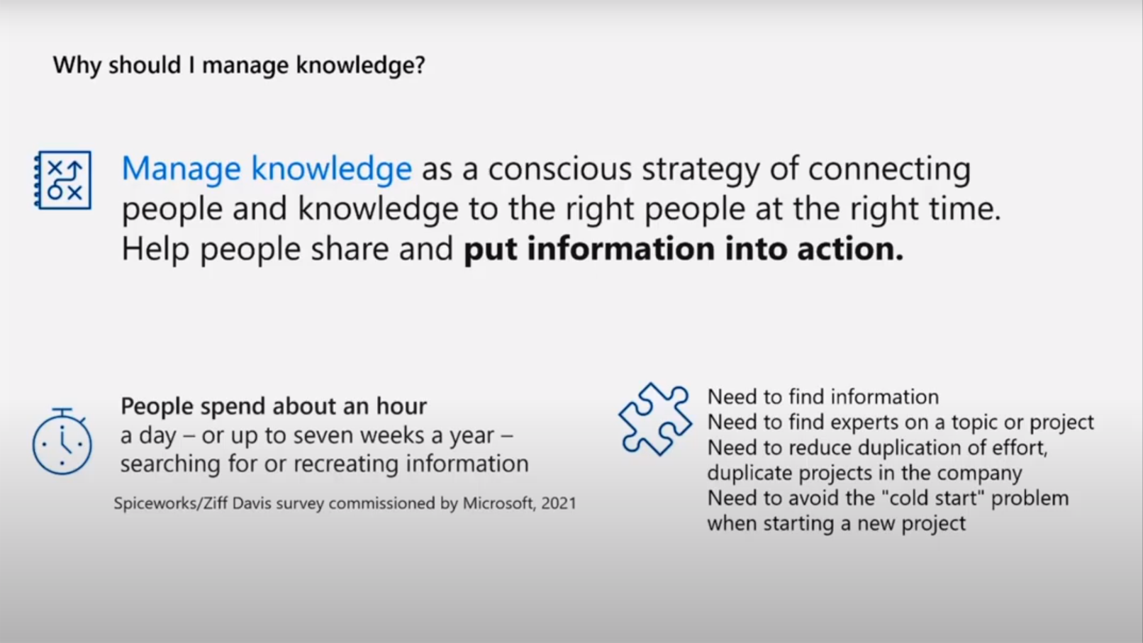
Viva Topics
What you need to know before you get started

Slide 42
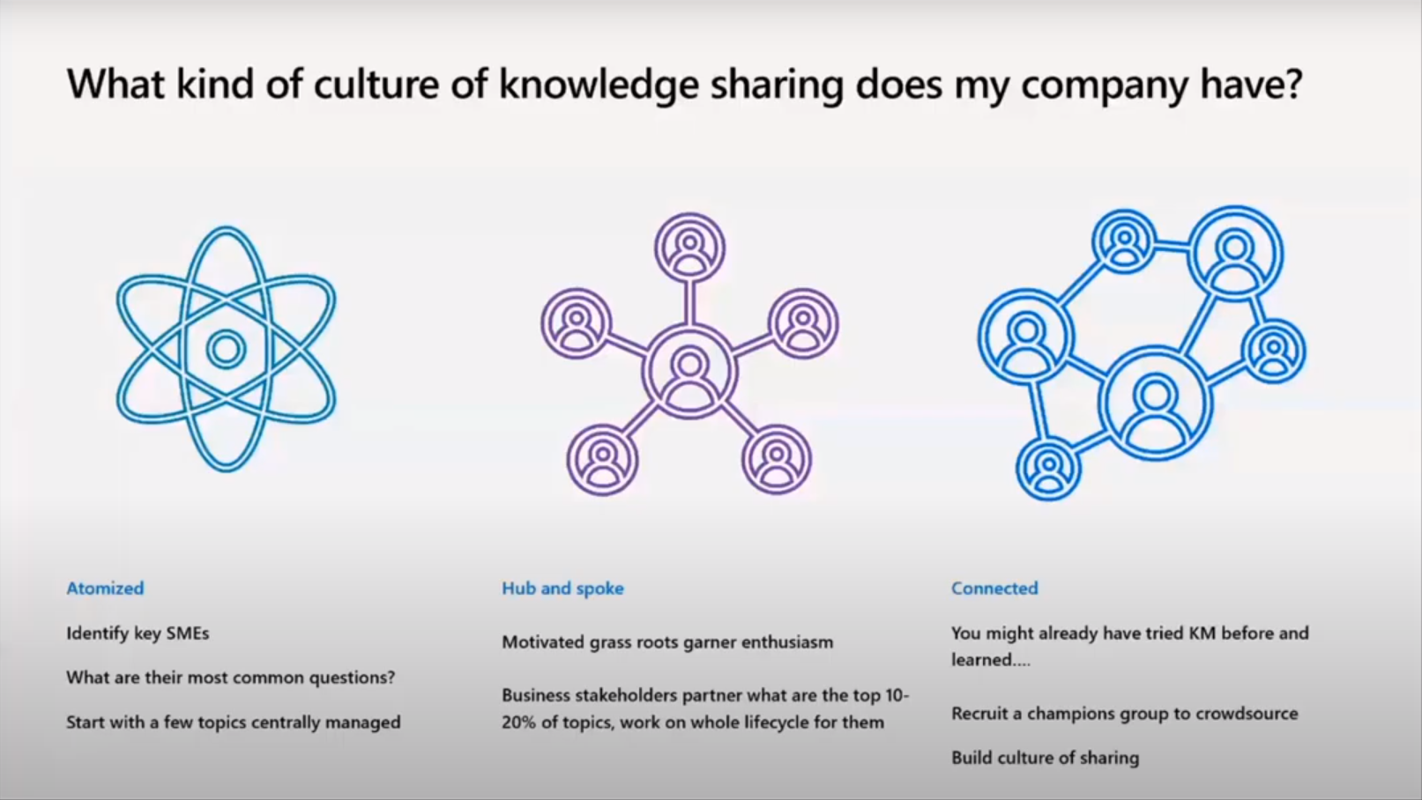
Viva Topics
What you need to know before you get started

Slide 43
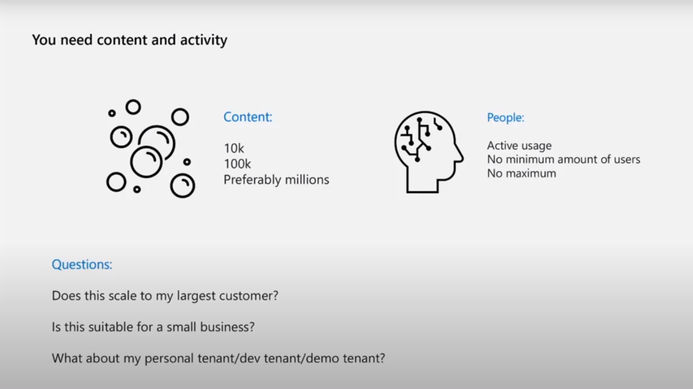
Viva Topics
What you need to know before you get started

Slide 44
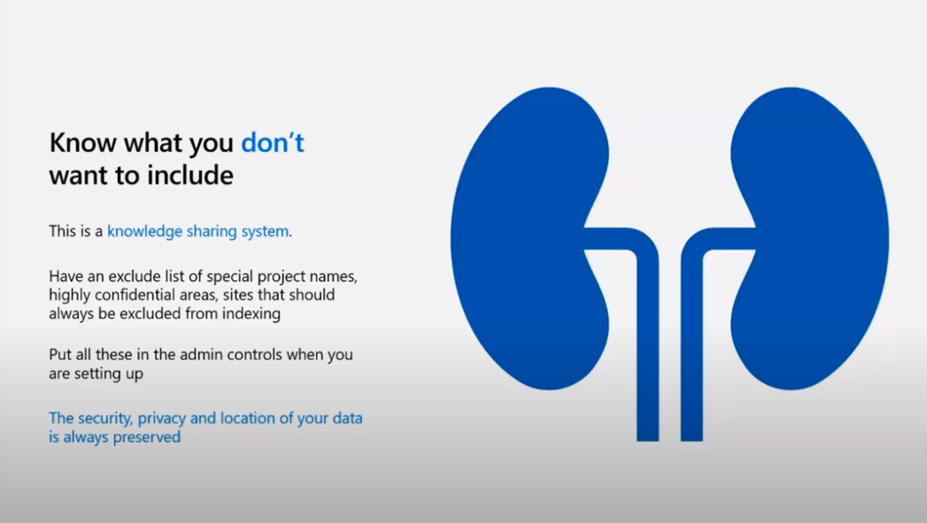
Viva Topics
What you need to know before you get started

Slide 45
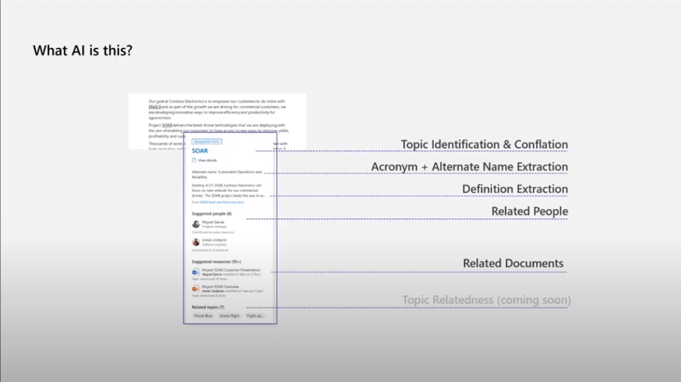
Viva Topics
What you need to know before you get started

Slide 46
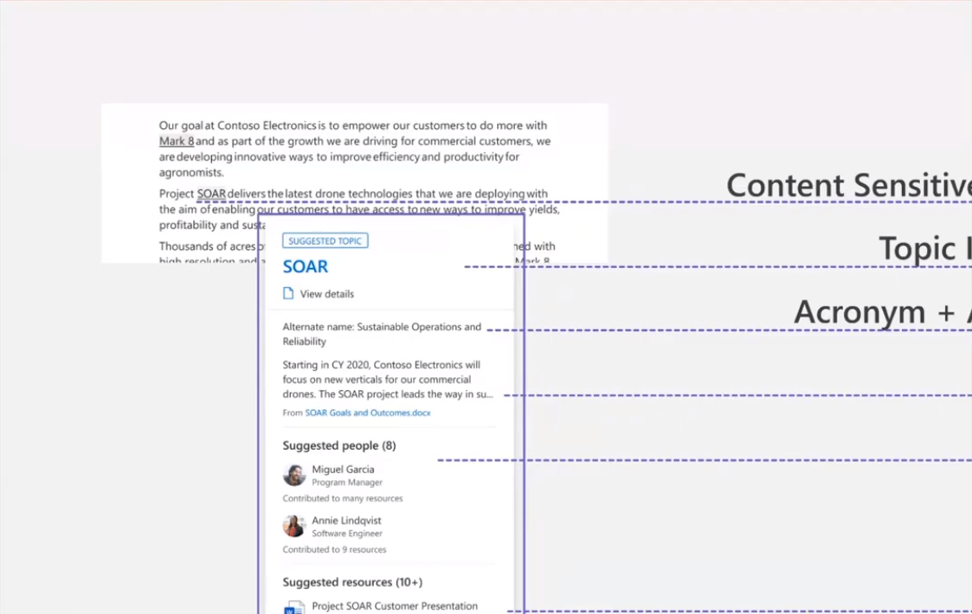
Viva Topics
What you need to know before you get started

Slide 47
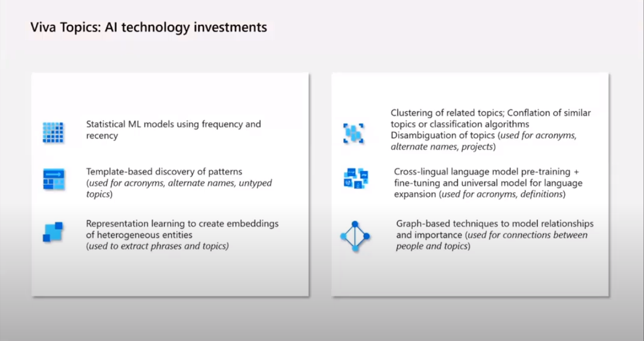
Viva Topics
What you need to know before you get started

Slide 48
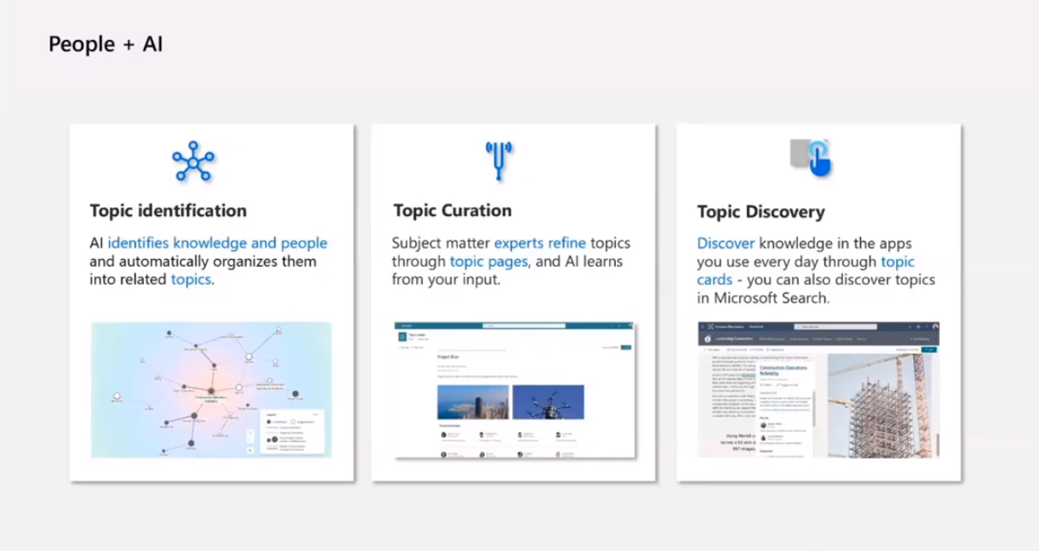
Viva Topics
What you need to know before you get started

Slide 49
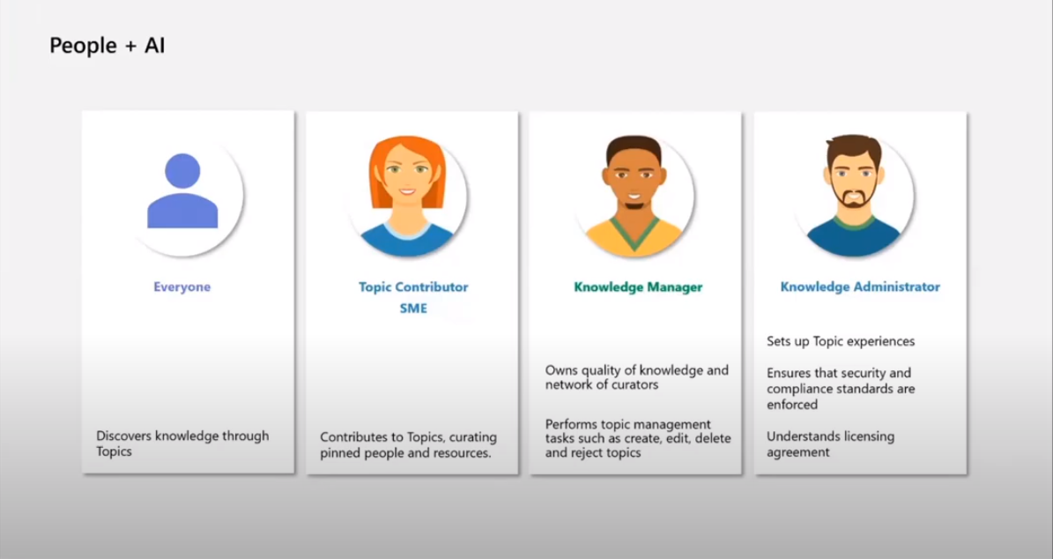
Viva Topics
What you need to know before you get started

Slide 50
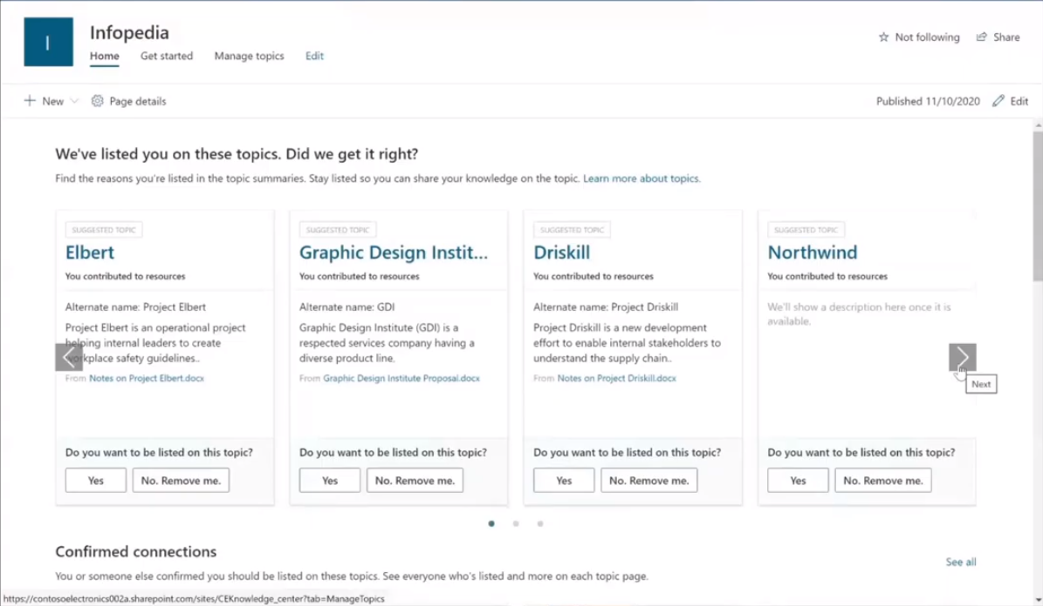
Viva Topics
What you need to know before you get started

Slide 51
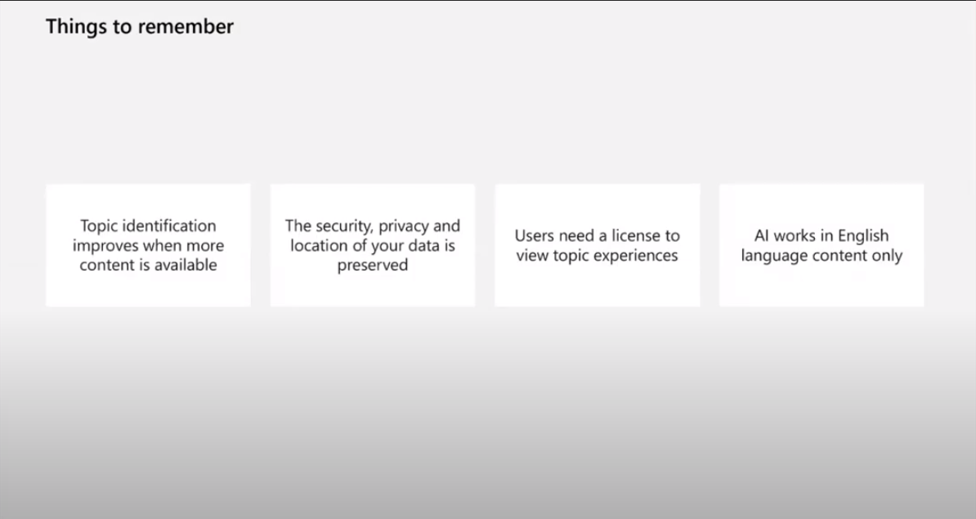
Viva Topics
What you need to know before you get started

Slide 52
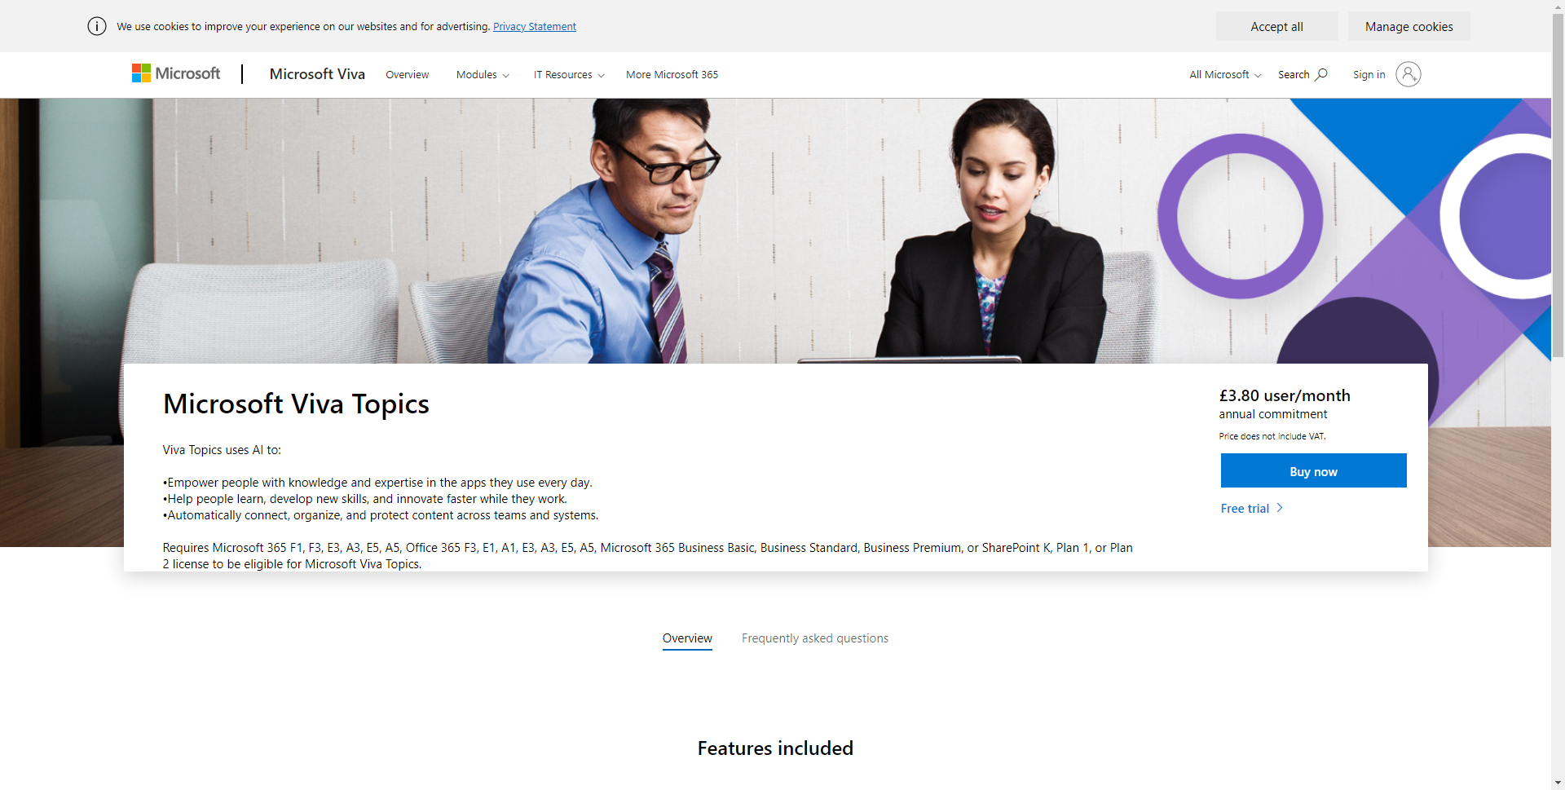
Viva Topics
What you need to know before you get started

Slide 53
Resources
Microsoft Viva
aka.ms/Viva
Mivrosoft Viva Topics
aka.ms/Viva/Topics
SharePoint Syntex
aka.ms/SharePointSyntex
Content Services Partner Program
aka.ms/ContentServicesProgram
Microsoft Knowledge & Content Services Resource Center
aka.ms/KCS
Notes:
PowerShell - https://docs.microsoft.com/en-us/powershell/sharepoint/sharepoint-online/introduction-sharepoint-online-management-shell?view=sharepoint-ps
Register home site - https://docs.microsoft.com/en-us/sharepoint/home-site
Root site - https://docs.microsoft.com/en-us/sharepoint/modern-root-site#replace-your-root-site
Global nav - https://docs.microsoft.com/en-gb/SharePoint/sharepoint-app-bar?WT.mc_id=M365-MVP-5003360#customize-global-navigation-in-the-app-bar
Install files - https://www.microsoft.com/en-us/download/confirmation.aspx?id=102888

Slide 54





Thank you
Knut Relbe-Moe
@knutrelbemoe
https://linkedin.com/in/knutrelbemoe

